Slide 1
SSW-810: Software Engineering Tools and Techniques
Building Web Sites with Python and Flask
Dr. Raz Saremi
Software Engineering
School of Systems and Enterprises
This Lecture is based on material from Prof. Jim Rowland

Slide 2
Acknowledgements
This lecture includes material from:
http://www.tutorialspoint.com/dbms/
https://www.tutorialspoint.com/html/
https://gertjanvanhethofblog.wordpress.com/2016/02/10/exploring-flask-on-raspberry-pi/
http://flask.pocoo.org/

Slide 3

Today’s topics
Tying it all together
HTML
Integrating web pages and Python
Flask
Building a simple web site to display student information
Populating forms with Python and Flask

Slide 4
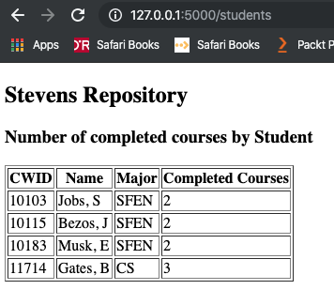
What problem are we trying to solve?
Goal: build a simple website
Display data from our SQLite database
Limitations:
Not a lesson in HTML
Not a lesson in good web design

Slide 5
Oversimplified Web Overview
Web Browser
http://testpad.asna.com/tutorials/Images/DataServerWebServer.gif

Slide 6
Static and Dynamic HTML
Many HTML pages have static content
hello.html
Kitten videos
Other pages generate HTML dynamically
Display the latest messages from a blog
Display the latest Tweets
Display information from a database
The Web Server may generate the HTML dynamically using information retrieved from a database or other source

Slide 7
Oversimplified Web Overview
1. GET hello.html
4. Render the HTML
3. Return the HTML
2. Retrieve hello.html
<!DOCTYPE html>
<html>
<body>
<h1>Hello World!</h1>
</body>
</html>
Not needed in this example…
http://testpad.asna.com/tutorials/Images/DataServerWebServer.gif

Slide 8
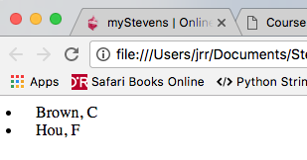
Dynamic Web Pages
1. GET All Students
5. Render HTML
4. Return generated HTML
<!DOCTYPE html>
<html>
<TABLE>
<LI>Brown, C</LI>
<LI>Hou, F</LI>
</body>
</html>
3. Get student data
2. Create HTML dynamically
http://testpad.asna.com/tutorials/Images/DataServerWebServer.gif

Slide 9
Python, Flask, Jinja2
Flask serves the role of the Web Server
https://gertjanvanhethofblog.wordpress.com/2016/02/10/exploring-flask-on-raspberry-pi/

Slide 10
Hello World with Flask
Install Flask and its supporting packages
Create a web server program with Python and Flask
Return “Hello world” to the browser
Run our web server program
Point to our web server with a browser
Say “Hello”!

Slide 11
Installing the packages
Mac/Unix
$ pip3 install flask
C:\> pip3 install flask
Windows
Add the Flask package to your Python environment

Slide 12
Background: Python decorators
Python decorators provide additional information about a function or class definition
Decorators augment the definition of a function or class without changing the definition of the function or class
@staticmethod
def foo(): “”” This is a static method “””
@app.route(‘/hello’)
def hello_page() -> str:
return “Hello world!”
Specify that foo is a static method
Call hello_page() function when the user requests the ‘hello’ page. Return HTML to be rendered in the web browser
Return any valid HTML to be rendered by the browser

Slide 13
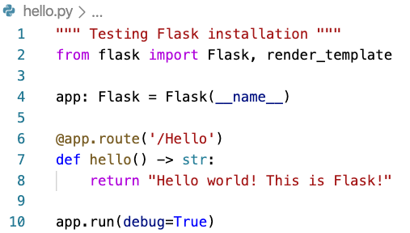
Step 1: Flask Hello World
Create hello.py which will be our web server
Call ‘hello()’ when the browser requests the /Hello page
The return value is HTML that will be rendered by the browser
Automatically restart Flask if the file changes

Slide 14
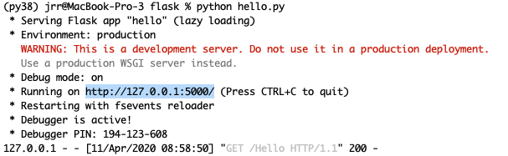
Step 2: Running the Flask Web Server
hello.py program from previous slide
Run your hello.py program from a shell/command window, or an IDE
Hit ^C to stop the process to shut down the server after testing or to make changes to the program
Someone accessed your Hello page with a GET request

Slide 15
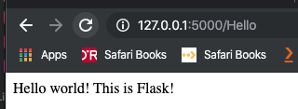
Step 3: Accessing the Flask Web Server
1. Run your hello.py program from a shell/command window of IDE
2. Open your browser and enter 127.0.0.1:5000/Hello as the URL
3. Hit ^C to stop the Python program
Recreate this scenario on your laptop to verify that Flask is installed and working properly.

Slide 16
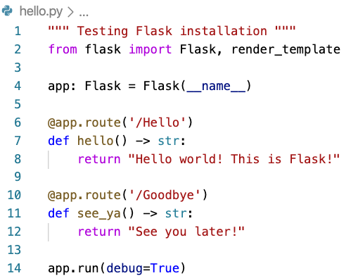
Add Goodbye page to our site
Our Flask web server can support many pages
Each @app.route(URL) displays a different web page

Slide 17
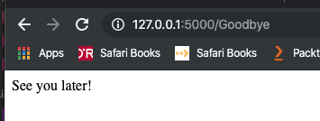
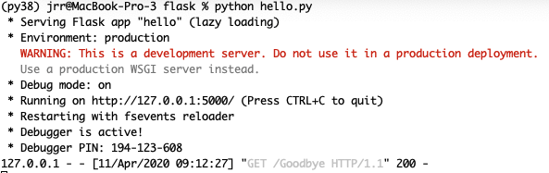
Add Goodbye page to our site
Test the new feature!

Slide 18
Making pages more interesting
We want to support more interesting pages
e.g. display variables from Python in the HTML page
(the first step in dynamic web content)
Flask works with many components, including Jinja2
Jinja2 provides a bridge between Python and the generated HTML
https://gertjanvanhethofblog.wordpress.com/2016/02/10/exploring-flask-on-raspberry-pi/

Slide 19
Flask application directory structure
Flask/Jinja2 requires a specific directory structure
MyAppDir/
templates/
base.html
template1.html
static/
scripts
my_program.py
template2.html
styles
my_css.css
my_script.js
Javascript programs
CSS files
Define the common page layout for all pages
Templates define individual pages and combine HTML and Python code

Slide 20
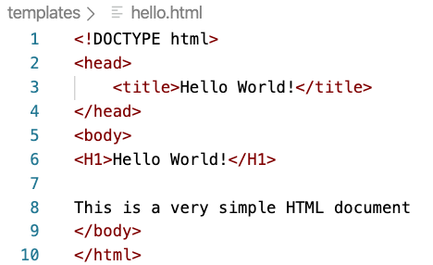
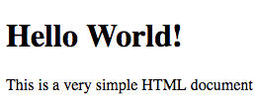
HTML Intro
HTML5 – HyperText Markup Language
A language to specify the content and the appearance of pages
<tag> provides layout hints </tag>

Slide 21
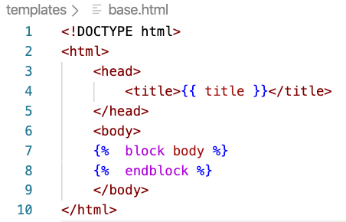
Jinja2 base.html
templates/base.html defines a base template that will inherited by other pages in your project
This is especially helpful when using CSS or creating multiple pages with a consistent look and feel
{{ title }} will be replaced by a value provided by your program in the HTML
Everything between
{% block body %} and
{% endblock %}
will be replaced by a template page that inherits from this page

Slide 22
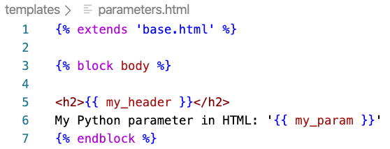
Jinja2 templates
templates/your_template.html inherits from the base template in base.html and adds HTML to your specific page
Define the block body that will plug into base.html
{{ my_header}} and {{ my_param }} will be replaced by values from your Python program
{% statement %} is interpreted by Jinja2

Slide 23
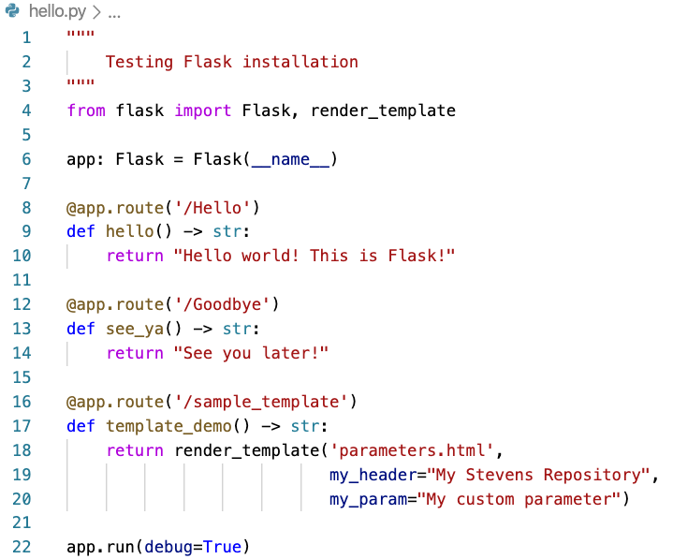
Jinja2 templates
Apply the template from your Python program
Import render_template from flask
render_template(template, params) combines the specified template.html, base.html, and parameter values from your Python program to create an HTML document
Add a new web page

Slide 24
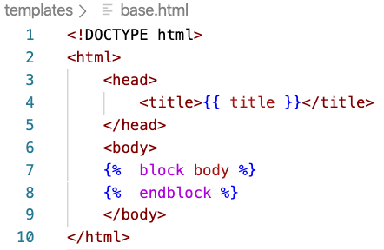
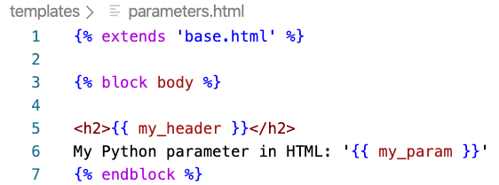
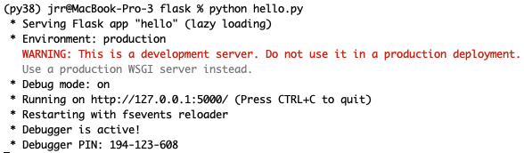
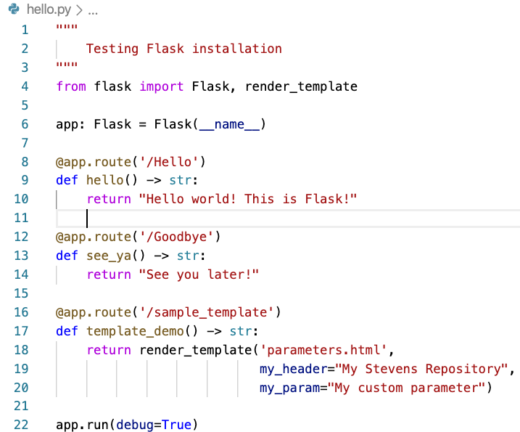
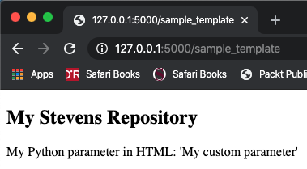
Jinja2 templates
1. templates/base.html
2. templates/parameters.html
4. Terminal running hello.py
3. hello.py
Passed to the template
5. Brower rendering sample_template

Slide 25
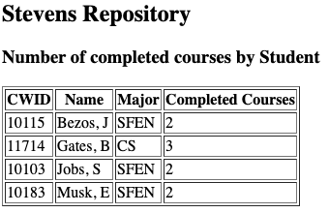
Moving Student Data to the Web
Goal: present student information from student repository as a web page
We need to generate this web page dynamically from our Python program

Slide 26
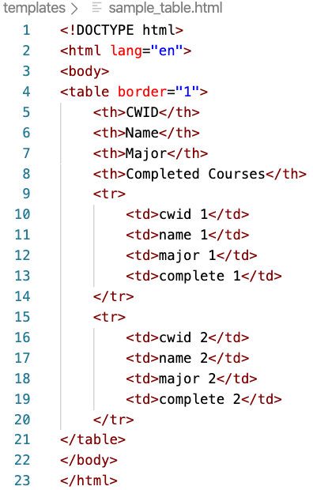
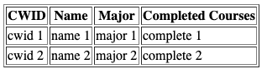
Intro to HTML Tables
HTML for four column, two row table
TH: Table Header (column)
Table rendered in the browser
TR: Table Row
TD: Table Data (1 column in 1 row)
Goal: update our template to generate HTML for an arbitrary list of student data

Slide 27
Displaying tables with Flask & Jinja2
We’ve seen HTML for tables
We know how to pass parameters from Python to Jinja2
How to display Python containers in HTML?
Store values in a dict and pass to Jinja2 as parameters
Jinja2 supports iterating through sequences
<table>
{% for item in sequence %}
<tr>
<td> {{ item }} <\td>
<\tr>
{% endfor %}
</table>
Jinja2 iterates through the items in a sequence passed from Python
Use the value from the sequence
End of the Jinja2 for loop

Slide 28
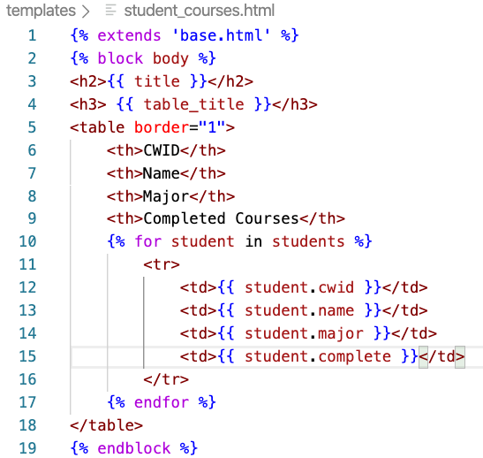
Displaying tables with Flask & Jinja2
Update templates/student_courses.html
Surround the table with borders
<th> table column headers </th>
We don’t know, and don’t care, how many rows in students
<tr> Table Row </tr>
Add a row to the table with 4 columns for each student in the list of dicts passed in from Python

Slide 29
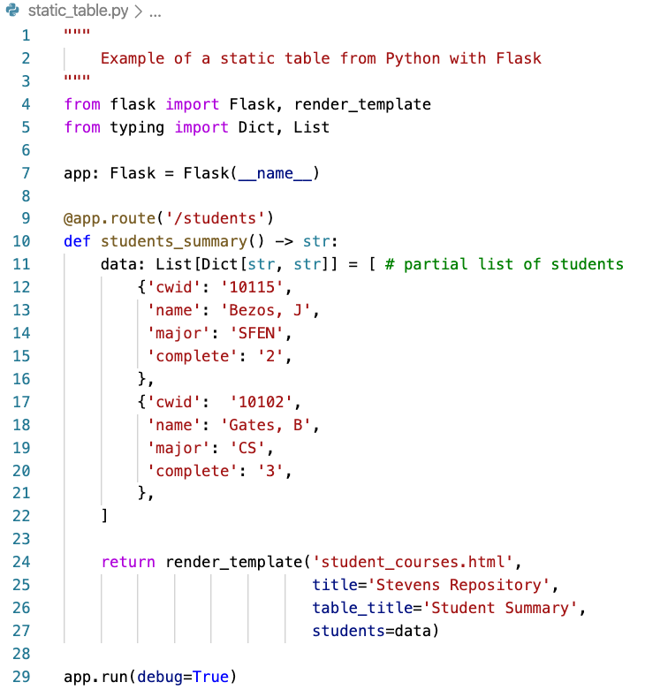
Displaying tables with Flask & Jinja2
Update static_table.py
Jinja2 supports JSON format for complex data
Pass in a list of students in JSON format
Python represents JSON as a dictionary with keys and values
Access each key/value separately in template/*.html
Pass the list of dicts to the HTML template

Slide 30
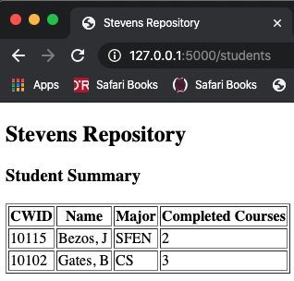
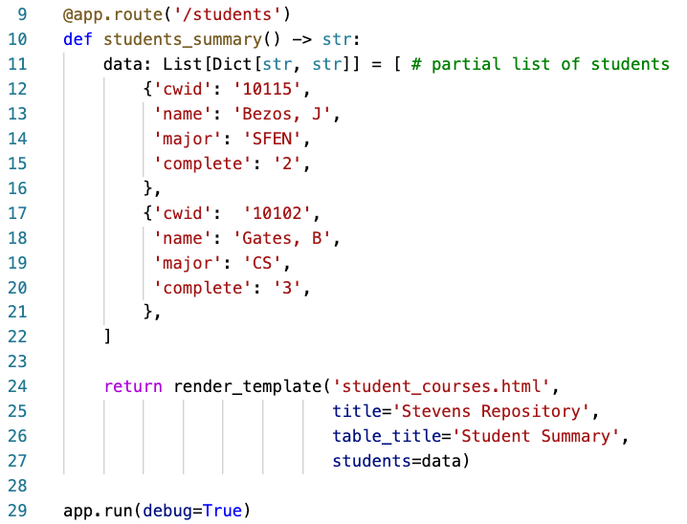
Displaying tables with Flask & Jinja2
templates/student_courses.html
Browser Window
static_table.py

Slide 31
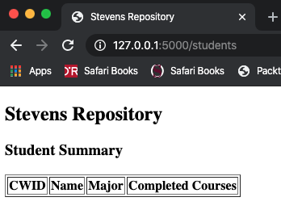
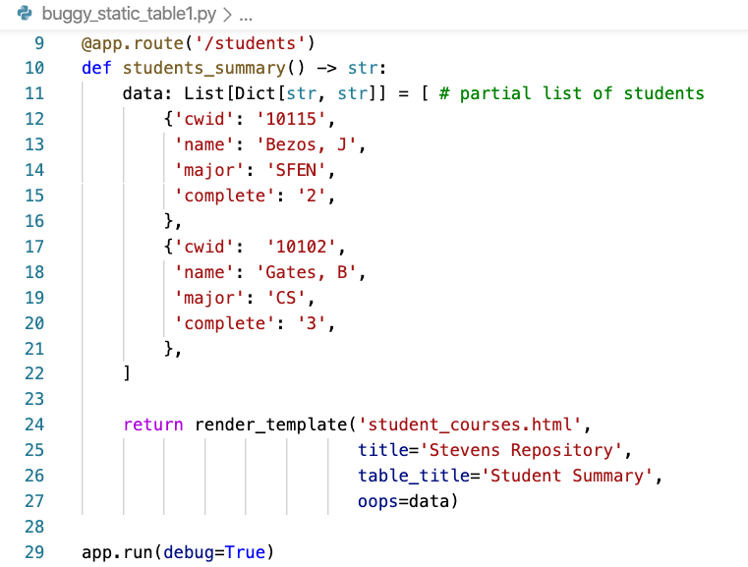
When things go wrong… missing rows
templates/student_courses.html
unchanged
Missing data rows!
Oops! The variable names must match to pass data from .py to .html

Slide 32
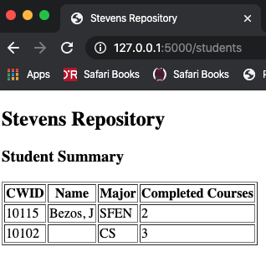
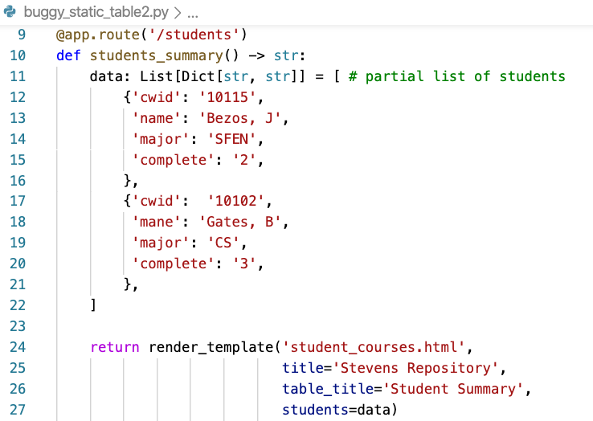
When things go wrong… missing columns
templates/student_courses.html
unchanged
The variable names match… Must be something else
Missing data field!
Oops! The attribute names must match

Slide 33
Running database queries from Python
import sqlite3
Specify the Sqlite database file name
Specify the query
Open a connection to the database
Execute a query
Fetch the results
Use the results in your Python program

Slide 34
Display # completed courses by student
Steps:
Write a query to pull the data
Create a template for the new web page
Update Stevens.py with a new function to return the HTML for the web page on our growing web site
Connect to the database
Run the query
Convert the results to a list of dicts
Render the new template and the database query results to Jinja2
Earn fame and fortune
You’ll need to do this for the homework assignment!

Slide 35
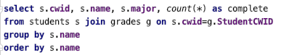
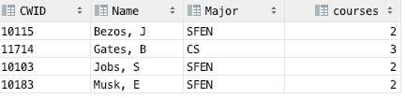
Query to compute completed courses
DataGrip
Query
Query Results

Slide 36
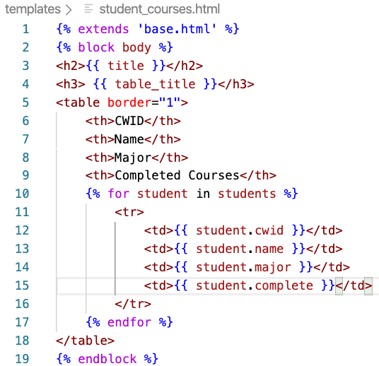
Generate a new template
Desired output in the browser
Reuse template from the static table

Slide 37
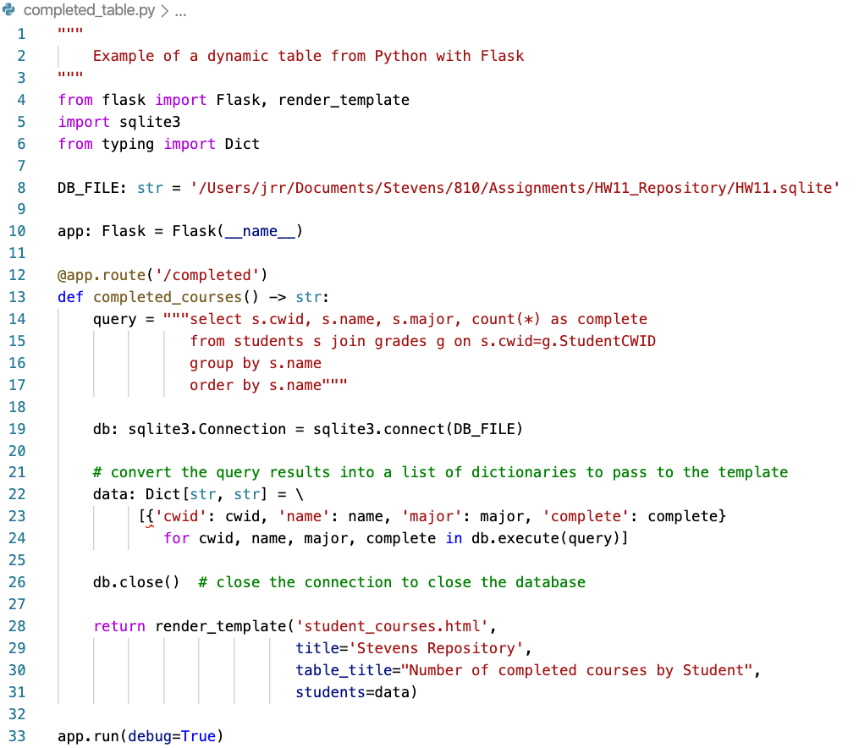
Update completed_table.py
Specify the query
Connect to the database
Convert the query results into a list of dictionaries
Render the template

Slide 38
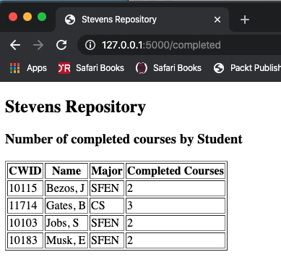
Success! Display the results
The new template
Titles are passed to the template
Database query results presented on a web page

Slide 39
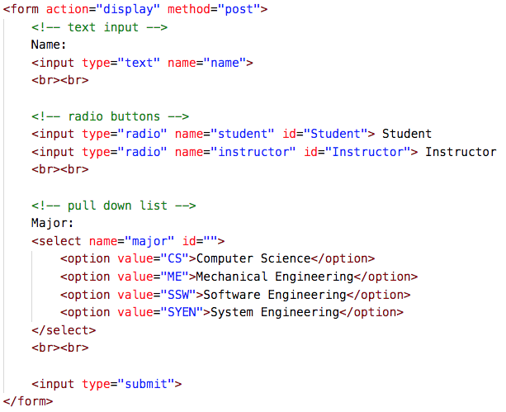
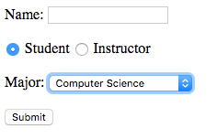
Intro to HTML Forms
Rendered Form
HTML

Slide 40
Populating HTML Forms with Flask
Use Flask and database queries to populate forms
Replace hard-coded values with computed values

Slide 41
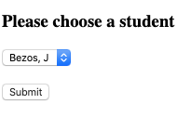
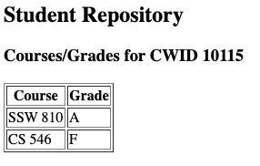
To Do:
Render a page with all student names
Ask the user to choose student
Display all courses and grades for that student
All student names from database
Results for specified student

Slide 42
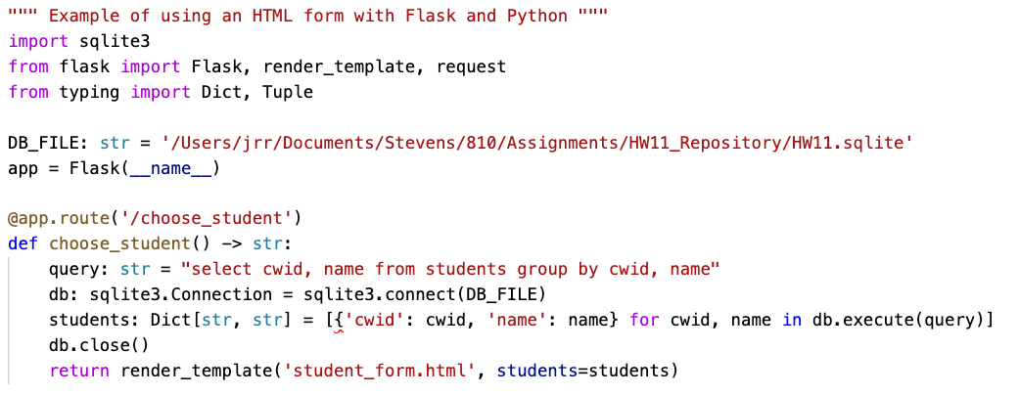
Populating HTML Forms with Flask
student_form.py – a Flask app runs a query to pull the student names and renders students.html to present a form
Replace hard-coded values in the form with values from the database
Render a form with student names and allow user to choose
Retrieve all student names from database

Slide 43
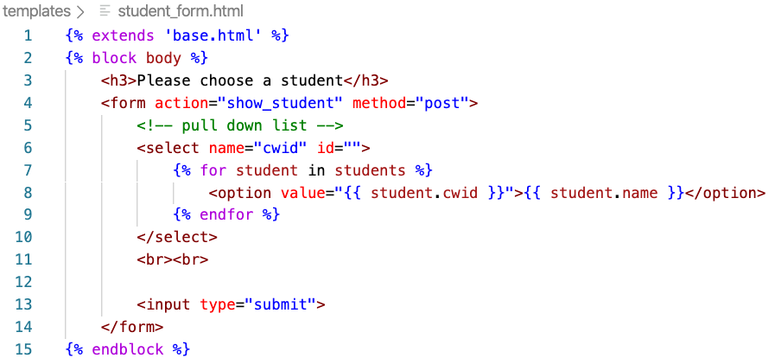
student_form.html
Display a pull-down menu with all students’ names
Page to render on submit
Add a drop down menu option for each student’s name
Return the CWID
Display the student’s name

Slide 44
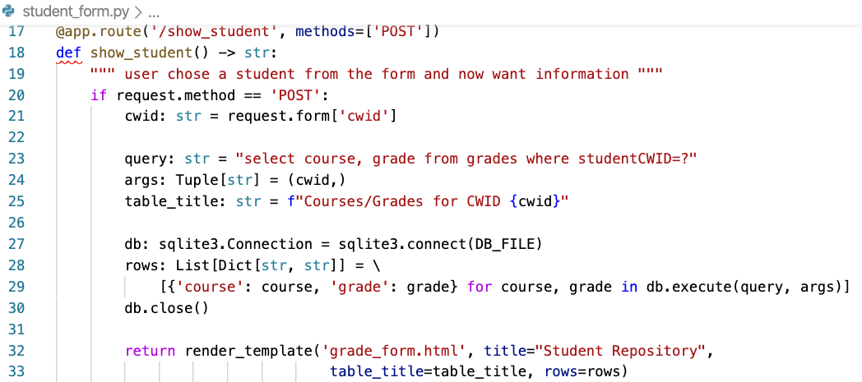
Retrieve the student courses/grades
Page rendered as result of post request from form
Retrieve the cwid selected on the form
Retrieve the courses and grades from database
Render page with the results

Slide 45
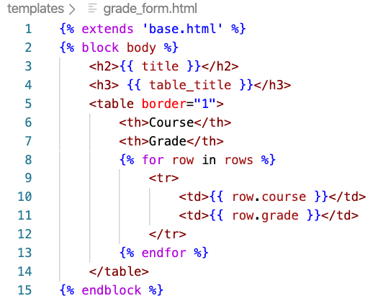
grade_form.html
Page rendered as result of post request from form
Display a table with the courses and grades passed in from Python

Slide 46
Success!
Rendered a menu button with all student names
Asked the user to choose student
Displayed all courses and grades for that student
All student names from database
All student names from database
Results for specified student
Results for specified student

Slide 47
Learning more about Flask Extensions
Flask supports many extensions to add functionality
Flask-Ask – create Amazon Echo apps easily
Flask-Login – user session management, logging in/out
Flask-Mail – send mail from Flask
Flask-MongoAlchemy – MongoDB support
Flask-Oauth – common login support
Flask-Principal – user authentication management
Flask-SQLAlchemy – support SQLAlchemy
Flask-Uploads – upload and serve files
Flask-User – User account management
See : http://flask.pocoo.org/extensions/

Slide 48
Learning more
Flask resources
http://flask.pocoo.org/
http://flask.pocoo.org/docs/0.12/tutorial/introduction/
https://blog.miguelgrinberg.com/post/the-flask-mega-tutorial-part-i-hello-world
Python and SQLite
http://sebastianraschka.com/Articles/2014_sqlite_in_python_tutorial.html
Python and Databases
http://www.sqlalchemy.org/

Slide 49

Questions?

Slide 50

Today’s topics
Decorators
Encapsulation
@property, @attribute.setter
Polymorphism
Dynamic typing with Duck Typing
Class attributes
Static methods

Slide 51
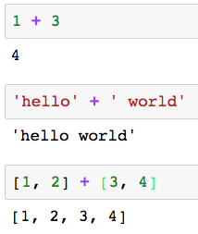
Polymorphism
Polymorphism allows an operator to behave differently depending upon the types of the operands
How does this work?
How does Python know which version of ’+’ to apply?
integer arithmetic
string concatenation
list concatenation

Slide 52
Dynamic and Static Typing
Statically typed
C++, Java
Variables are declared with a static type
The compiler uses the static type information to support polymorphism
Dynamically typed
Python
An object’s type is determined at run time
Python chooses the appropriate class method based on the type of the object

Slide 53
Duck Typing
Duck typing is a dynamic typing method
Python uses duck typing to support polymorphism
If it walks like a duck and quacks like a duck, it’s probably a duck
Python: if an object has a relevant property, then apply it
Duck typing supports polymorphism with or without inheritance

Slide 54
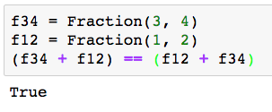
Duck typing example
Recall the Fraction homework from earlier in the semester
We used Python’s magic methods to support inline operators
Python determines the type of f34 and f12 at run time to choose the appropriate version of __add__() to invoke
We can use Duck Typing with or without inheritance to simplify out design and implementation

Slide 55


Slide 56
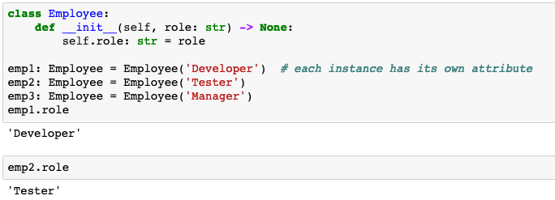
Instance Attributes vs Class Attributes
Instance attributes are replicated in each instance of a class
Defined in __init__() or added after the class is defined
A distinct instance of role is included in each instance of class Employee

Slide 57
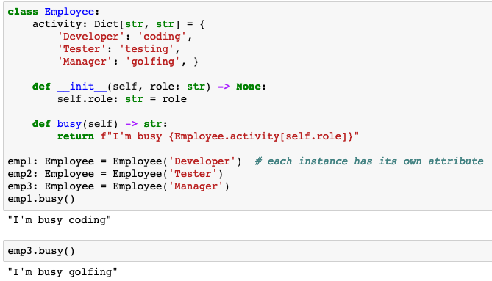
Instance Attributes vs Class Attributes
A Class attribute exists exactly once across all instances of a class
Defined outside __init__() or after the class is defined
A single instance of Employee.activity is shared across every instance of class Employee

Slide 58
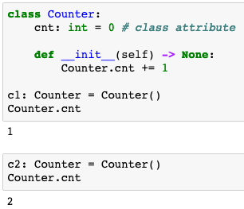
Referencing class attributes
Reference the class attribute as
Class.attribute
How should we reference class attributes?
Reference instance attributes as instance.attribute
Reference class attributes as Class.attribute

Slide 59
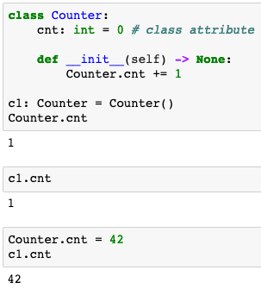
What could possibly go wrong?
We can also reference class attributes as instance.class_attribute BUT that can lead to unexpected behavior
Oops! c1.cnt changed because it is a reference to Counter.cnt
Treating c1.cnt like an instance attribute, but it’s a class attribute
Oops!

Slide 60
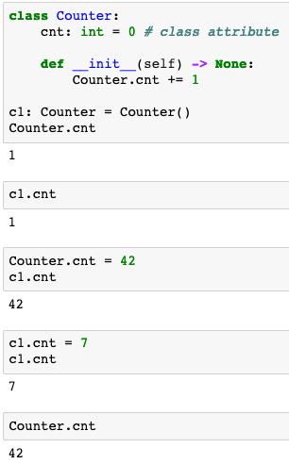
What could be even more confusing?
Assigning a value to instance.class_attribute creates a new instance attribute that takes precedence over the class attribute
c1.cnt references class attribute in c1
c1.cnt = 7 creates a new instance attribute named cnt only in c1
Now, c1.cnt references a new
instance attribute in c1,not the class attribute

Slide 61
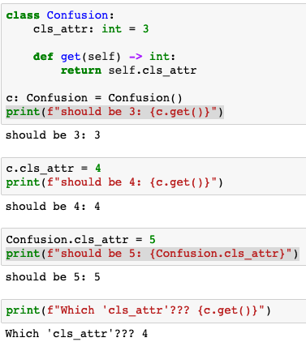
Class Attributes and self
Self is just an instance – avoid self.class_attribute
Python checks first for an instance attribute and then for a class attribute
No instance attribute named ‘cls_attr’ so use class attribute Confusion.cls_attr
Create a new instance attribute named ‘cls_attr’ in self
Change the value of class attribute Confusion.cls_attr
Use self’s instance attribute ‘cls_attr’

Slide 62
Static Methods
Static methods look just like other methods but are not associated with a specified class instance
No self parameter because the method is not associated with a a specific instance
Instance attributes are not available – no class instance
Class attributes are available
Static methods can be replaced with procedural function calls
Static methods offer extra encapsulation and consistency
Static methods are fairly unusual

Slide 63

Static Methods
conv is a class instance. Only one instance across all instances of class DateCompare
@staticmethod is decorator
No self because this is a static method

Slide 65
Stevens Data Repository
HW09: Build Stevens Data Repository
Students
Instructors
Print Student Summary
Print Instructor Summary
HW10: Enhance Stevens Data Repository
Add majors
Enhance Student Summary with remaining classes
HW11: Store data in SQL database
HW12: Present the data with a Flask web interface

Slide 66

Questions?

